Slide 1
Beaks of Finches

Slide 2
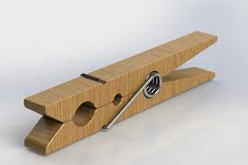
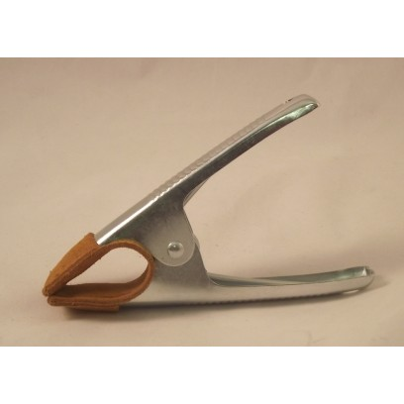
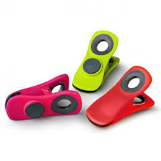
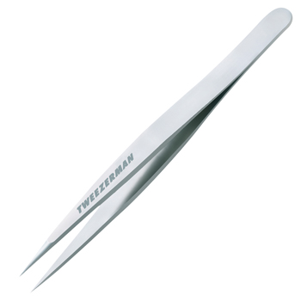
4 Different Beaks
“Clothespin”
“Metal Clip”
“Plastic Clip”
“Tweezers”

Slide 3
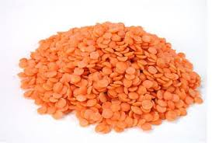
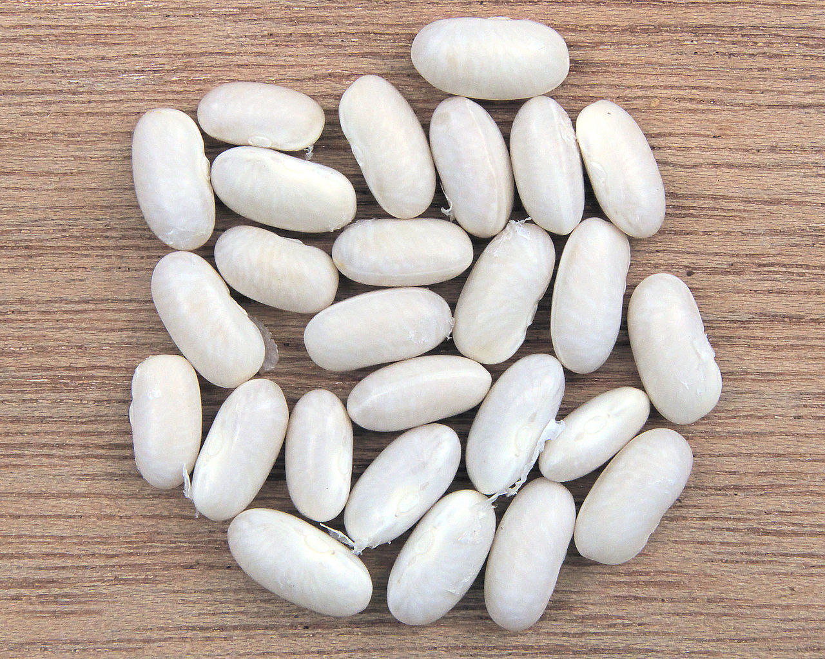
2 Different Seeds
“Small Seeds”
Large Seeds”

Slide 4
Round 1 Sample Data (Metal Clip)
Partner 1
Trial 1: 11
Trial 2: 9
Partner 2
Trial 3: 7
Trial 4: 13

Slide 5
Round 2 Sample Data (Metal Clip, New Island = Large Seeds)
Partner 1
Trial 1: 15
Trial 2: 19
Partner 2
Trial 3: 16
Trial 4: 18

Slide 6
Round 3 Sample Data (Metal Clip, New Island = Large Seeds)
Partner 1
Trial 1: 8
Trial 2: 6
Partner 2
Trial 3: 4
Trial 4: 6

Slide 7
Variation
The beaks of the finches showed variation!

Slide 8
Competition
Birds with the same and different species would compete for the same resources

Slide 9
Struggle for Survival
Not all birds survived! Only those that were best adapted to the island survived

Slide 10
Adaptation
Some birds had adaptations for small seeds (small beaks). Some had adaptations for large seeds (large beaks)

Slide 11
Environment
The environment changed from island to island. One island had an environment that gave small seeds. The other had an environment that gave large seeds

Slide 12
Selecting Agent
A trait that can be dominant. In this case, beak size was our selecting agent

Slide 13
Class Results
Present at beginning of activity:
4
Metal Clip, Plastic Clip, Clothespin, Tweezers

Slide 14
Class Results
Successful at feeding in Round One on the original island – fed on small seeds, did not need to migrate
2
Plastic Clip and Tweezers

Slide 15
Class Results
Not Successful at feeding in Round One on the original island – fed on small seeds, had to migrate to the new island
2
Clothespin and Metal Clip

Slide 16
Class Results
Successful at feeding in Round Two on the original island – fed on small seeds
2
Tweezers and Plastic Clip

Slide 17
Class Results
Successful at feeding in Round Two on the new island – fed on large seeds
1
Metal clip

Slide 18
Class Results
Not successful at feeding in Round Two on either island – species dies out
1
Clothespin

Slide 19
Class Results
Successful at feeding in Round Three on the original island – fed on small seeds
1
Tweezers

Slide 20
Class Results
Successful at feeding in Round Three on the new island – fed on large seeds
1
Metal Clip

Slide 21
Class Results
Not successful at feeding in Round Three on either island – species eliminated
1
Plastic Clip

