Slide 1
Lab 16 Remake Guide
Relationships and Biodiversity

Slide 2
Overview
Answer all questions in the packet while filling out the data table on the last page

Slide 3
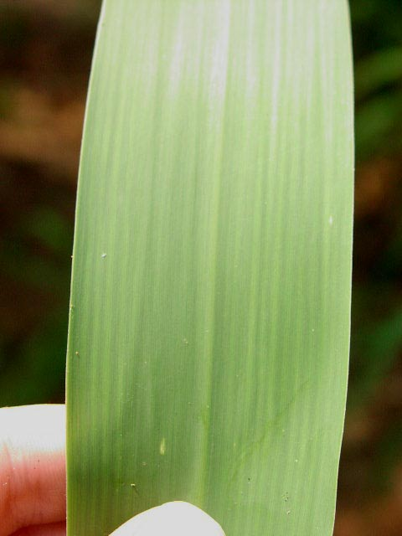
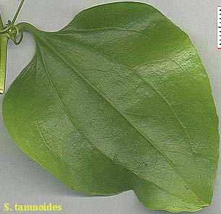
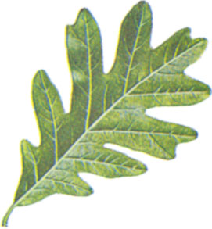
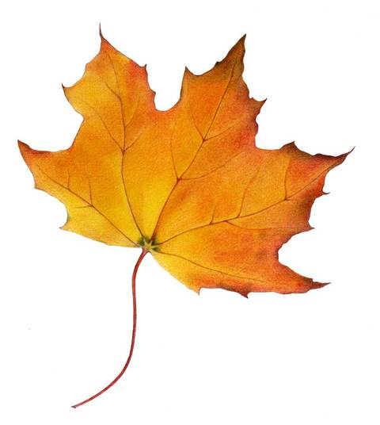
Test 1 - Structural Characteristics of Plants
QUESTION:
Which leaves most closely resemble the leaves produced by Botana curus?
Record your observations in the data table.
Species Z
Botana curus
Species Y
Species X

Slide 4
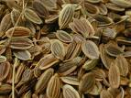
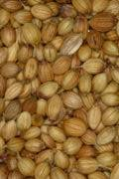
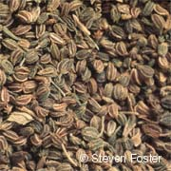
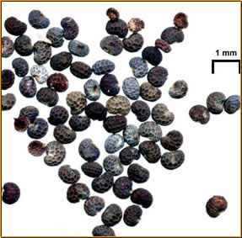
Test 2 – Structural Characteristics of Seeds
QUESTION:
Which seeds most closely resemble the seeds produced by Botana curus?
Record your observations in the data table.
Botana curus seeds
Species X seeds
Species Z seeds
Species Y seeds

Slide 5
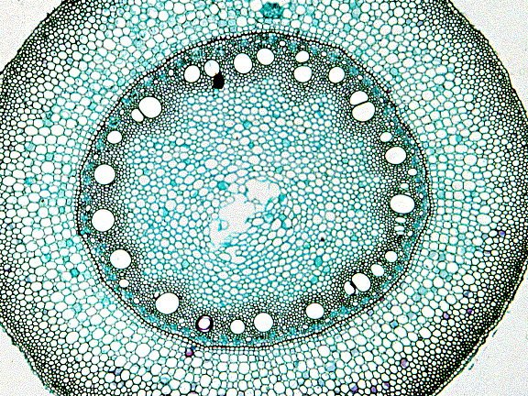
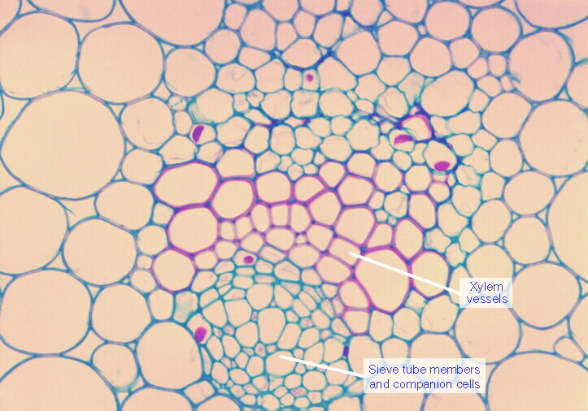
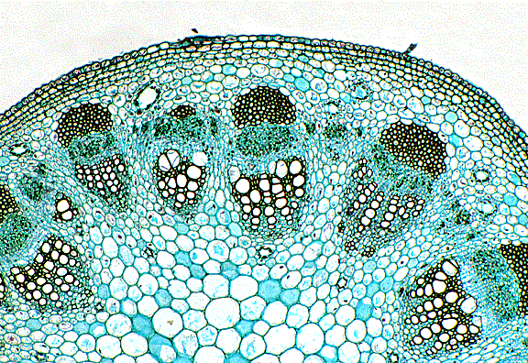
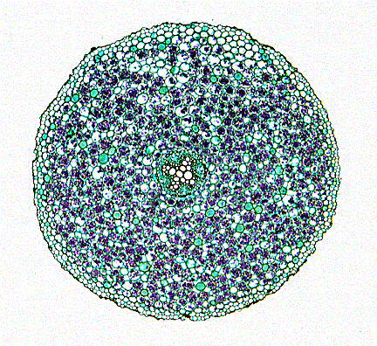
Test 3 – Microscopic Internal Structures of Stems
QUESTION:
Which stem structures most closely resemble the stem structures of Botana curus?
Record your observations in the data table.
Botana curus
Species X
Species Y
Species Z

Slide 6
Test 4 – Paper Chromatography to Separate Plant Pigments
Water migrates up paper via capillary action and carries plant pigments with it.
B.curus
X
Y
Z
B.curus
X
Y
Z
“Spot” your chromatography paper and label it with a pencil.

Slide 7
Test 5 – Indicator Tests for Enzyme M
Botana curus
Botana curus
(“fizzed” a little)
Species X
Species X
(no “fizz”)
Indicator Enzyme M
Species Y
Species Y
(“fizzed” a little)
Species Z
Species Z
(“fizzed” a little)
Add a small sprinkle of “Indicator Enzyme M”
Put two drops of each plant Extract in separate wells of the well tray.
Record your results.

Slide 8
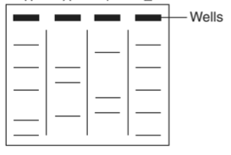
Test 6 – Gel Electrophoresis
Botana Curus X Y Z

Slide 9
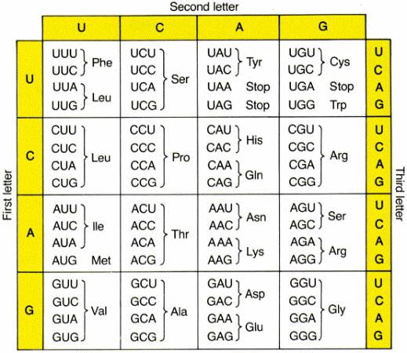
Test 7 – Amino Acid Sequence
This section is in your lab handout. Complete the amino acid sequence, then fill out the data table

